Slide 1

Spot-On Advice From A Seasoned Mentor
3:1 – 14
The Sufficiency of Jesus Christ
Week 46
22 March 2023

Slide 2

Colossians Overview
As we continue our study, in Colossians, we want to remember the overall theme of this epistle is the preeminence and sufficiency of Christ in all things.
In chapters 1 and 2, Paul develops the principle that Jesus Christ is sufficient as our Lord.
In this second major section (3:1 – 4:1), Paul emphasizes the sufficiency of Christ as our Life.
Here Paul turns our attention to the believers heavenly calling and their longing for the ultimate salvation that will come at Christ’s return.
Though eternal life already began for us when we received salvation by grace through faith, we await the full realization of that eternal life in the future.

Slide 3
Colossians Overview
The fact of our future glory should compel us to live new lives that follow the pattern of Christ in the “here and now.”
This new life in which we live as faithful imitators of Christ will affect all dimensions of our lives including our marriage, family, and even our employment.
In contrast to the speculative and cerebral notions of budding Gnostic heresies, the Christian life is meant to impact our present life on earth in a practical way -- lived out in the minute-by-minute here and now of everyday life.
And in order to live this new life, we need to depend entirely on the sufficiency of Jesus Christ, who is our Life.

Slide 4
Paul’s Pattern of Presentation
Christ Is Preeminent in All Things Supreme Lord - Sufficient Savior
Colossians 1 | Colossians 2 | Colossians 3 |  | Colossians 4
Supremacy of Christ |  | Submission to Christ
Doctrinal and Corrective |  | Practical and Reassuring
What Christ Did For Us |  | What Christ Does Through Us
Christ Our Lord |  | Christ Our Life | Christ our Love
Christ the Head of the Body | Christ the Lord of the Universe | Christ the Head of the Home
Instruction | Warnings | Exhortations | Reminders
Reconciliation | Creation | Submission | Conversation
His Person and Work |  | His Peace and Presence

Slide 5

Spot-On Advise from A Seasoned Mentor (3:1-14)

Slide 6
Colossians Lesson Overview
Swindoll … opens this lesson with a statement we have heard many times throughout our lives.
“Experience is the best teacher.” --- It sounds right, doesn’t it? But is it true?
It’s false! The truth is similar, but with an important qualification added: “Guided” experience is the best teacher”
Think about it! The experience of cooking without prior knowledge will likely result in a meal nobody wants to eat. Likewise, the experience of driving a car without any training will probably result in an accident.
However with the coaching of a seasoned chef and lessons from an experienced driver, we will get an edible meal, and get safely to our desired destination.

Slide 7
Colossians Lesson Overview
This is also true in relation to the whole of our lives. When we are young, our parents and teachers guide us, challenge us, correct us, and stretch us.
They help us overcome our weaknesses and enhance our strengths. Through their guidance, we grow and mature, and enter into more specific areas of interest and giftedness.
These wise mentors equip us to live skillfully and experience life fully.
In the first century, the Apostle Paul was a qualified experienced mentor, whose advise was reliable. His counsel was trustworthy. His warnings were constructive. His instructions were insightful. Those who attended to his teaching were sure to grow under his “guided” experience.

Slide 8
Colossians Lesson Overview
Colossians 3:1-14 provides a perfect example of Paul’s inspired leadership regarding how to live out the new life in Christ. In these verses:
He tells us what to think about as we seek to live life to the fullest (3:1-4).
He instructs us on what distractions we need to get rid of (3:5-9).
Then knowing that we have all formed some bad habits over the years, he shows us what we need in order to gain a fresh start (3:10-11).
He wraps up by outlining a list of essential virtues that we are to “put on” as part of our new life (3:12-14).
Let’s look at what this master mentor has to say!

Slide 9
Colossians 3:1– 4
¹ If then you were raised with Christ, seek those things which are above, where Christ is, sitting at the right hand of God. ² Set your mind on things above, not on things on the earth. ³ For you died, and your life is hidden with Christ in God. ⁴ When Christ who is our life appears, then you also will appear with Him in glory.

Slide 10
Colossians 3:1– 4
Picture Paul as your personal spiritual trainer standing before you saying, “Okay, I want to get into your head, because everything we do begins there. It’s the center of our thoughts, our emotions and our will. Let’s start with properly exercising the mind.”
So in Colossians 3:1, Paul urges those who have been “raised up with Christ” to direct their minds upward, “seeking the things above, where Christ is, seated at the right hand of God.”
If we’re associated with Christ’s death and resurrection, we’re also associated with His victorious ascension to the right hand of God.

Slide 11
Colossians 3:1– 4
We’re spiritually united with Him, and our thoughts and attitudes should be constantly drawn upward, not downward (3:2).
And if we are associated with Him in His death, resurrection and ascension (3:3), our minds should also anticipate the next stage in the work of Christ – His return (3:4).
Paul isn’t suggesting we live each day in a super-spiritual, out-of-touch la-la land, ignoring our lives on earth paying attention only to the things to come.
Swindoll quoting Richard Melick … who he says brings out the practical point of Paul’s image:

Slide 12
Colossians 3:1– 4
says … “This command called the Colossians to focus on matters related to the rule of Christ in the world. Since Christ is the sovereign one, his concerns should occupy the Christian.
The Believers values and loves were to be focused on the rule of Christ and their consecrated energies were to be devoted to making that rule a reality on earth.
The task of the Colossian church was to call people to Christ and away from earthly things.
It was to call people to LIFE.”

Slide 13
Colossians 3:1– 4
Next time the world gets us down or we’re in a funk and can’t seem to get out, we need to check our spiritual eyesight.
What’s our focus? Are we looking backward, downward, and inward – fixated on things below, obsessing over things on this horizontal plane, and surrendering to the world’s values and loves?
Or are we setting our gaze on things above, where Christ, “who is our life” (3:4), sits victorious, ready to return from heaven and rescue us from this wicked world?
A worldly focus will drag us deeper into the mire, but an upward heavenly focus – a focus on what Christ values and loves – will lift us out of it.

Slide 14
Colossians 3:5– 9
⁵ Therefore put to death your members which are on the earth: fornication, uncleanness, passion, evil desire, and covetousness, which is idolatry. ⁶ Because of these things the wrath of God is coming upon the sons of disobedience, ⁷ in which you yourselves once walked when you lived in them. ⁸ But now you yourselves are to put off all these: anger, wrath, malice, blasphemy, filthy language out of your mouth. ⁹ Do not lie to one another, since you have put off the old man with his deeds,

Slide 15
Colossians 3:5– 9
If we hire a fitness trainer to whip us into shape, we can be sure they will insist that we get rid of some things that slow our progress, set us back, or work against positive results.
We’ll no doubt be told to cut down on sweets, trim the fat, and avoid high-sugar drinks. It’s no different in our spiritual training.
In Colossians 3:5-9, our spiritual mentor Paul give us a handful of things we need to put off as we pursue a life that reflects the “things above.”
He reminds us that these sinful attitudes and actions will be the cause of God’s wrath coming upon this world, so they have no place in the lives of believers destined for eternity with Him.

Slide 16
Colossians 3:5– 9
Warning us that these sinful attitudes and actions are – and should continue to be – things of our past, things we once practiced but have abandoned for the sake of conformity to Christ. He then categorized them into the following three groups:
Sensuality (3:5)
Materialism (3:5)
Negative Emotionalism (3:8-9)

Slide 17
Colossians 3:5 – 9
Sensuality (3:5)
Paul first tells us to get rid of “Sensuality.” This group of behaviors include four practices that we are to consider our bodies dead to: “immorality, impurity, passion and evil desires.”
Immorality – this term is a translation of the Greek word “porneia.” It is a general term used for sexual immorality of any kind, including premarital and extramarital sexual relations, prostitution and homosexuality.
Impurity – this term refers to any thing unclean, unwholesome, and corrupting. This includes anything that pollutes our minds – especially inappropriate or suggestive images.

Slide 18
Colossians 3:5 – 9
Passion & Evil Desires – these two words belong together and they generally refer to strong desires gone bad.
Both terms deal with dwelling on immoral or impure things coddling unwholesome desires, obsessing over illicit cravings, and longing for things that are forbidden to Christians.
These sensual thoughts and behaviors are disastrous to a healthy Christian life.
We can’t tinker, toy, or dabble in these things and hope to remain untainted. There is only one stance a Christian should take with sensual things.
Consider yourself “DEAD” to them! (3:5).

Slide 19
Colossians 3:5 – 9
Materialism (3:5)
Next Paul tells us to get rid of “Materialism.” This includes greed and idolatry. The first relates to inner motivation, the second to outer manifestation.
Greed – is the driving desire to have more … and more … and MORE – a desire that can never be satiated. If you let greed get a foothold, it won’t be long before you’re worshipping and serving the very things you thought would satisfy you.
Idolatry – in the New Testament is giving any creature or human creation the honor or devotion which belonged to God alone, as well as giving any human desire precedence over God's will.

Slide 20
Colossians 3:5 – 9
Swindoll quoting Richard Foster describes how greed is manifest in idolatry:
“Compulsive extravagance is a modern mania. The contemporary lust for more, more, more, is clearly psychotic; it has completely lost touch with reality.”
That’s the world we live in. Enough is never enough. Things are never plentiful enough. So we end up worshiping those things that utterly fail to bring us lasting contentment or pleasure.
We are very spoiled, and very deceived. The more we have, the more we want. Paul says … we need to get rid of such out-of-control materialism.

Slide 21
Colossians 3:5 – 9
Negative Emotionalism (3:8-9)
Finally Paul tells us to get rid of “Negative Emotionalism.” Which includes anger, wrath, malice, slander, abusive speech, and lying. In short, we need to set aside all of our uncontrolled negative emotions.
This includes the sudden angry outbursts in which we lose our cool and say things that should not be said, as well as the long, quiet, stewing, seething, lingering bitterness that devours us from within.
Christians seeking to live a new life in Christ need to stop the habits of uncontrolled tempers, fits of rage, verbal abuse, malicious behavior, and hurtful and deceptive speech.

Slide 22
Colossians 3:5 – 9
Isn’t it interesting that Paul writes these things to Christian!
It’s easy to think that we who have accepted Christ as our Savior, who have the Spirit within us, will be free of negative emotionalism.
Yet! Swindoll says, some of the harshest, angriest, and most insulting letters I’ve received have come from fellow Christians. The ugliest words ever said to my face came from so-called brothers and sister in Christ.
Still, our spiritual life coach, Paul, says, “Put them all off since you put off the old self with its evil practices” (3:8-9).
These thinks should be in the past, not in the present and certainly not in our future!

Slide 23
Colossians 3:10–11
¹⁰ and have put on the new man who is renewed in knowledge according to the image of Him who created him, ¹¹ where there is neither Greek nor Jew, circumcised nor uncircumcised, barbarian, Scythian, slave nor free, but Christ is all and in all.

Slide 24
Colossians 3:10 – 11
In 3:5-9, Paul listed the vices we ought to put off as we seek to live the abundant Christian life.
Before providing the opposite list of virtues we ought to put on in 3:12 – 14, Paul supplies two transitional verses, in 3:10–11, that explain the source of these new character traits.
Since our old life without Christ came to an end when we “Put off the old self with it’s evil practices” (3:9).
Now our new life in Christ has begun as we “put on the new self who is being renewed” (3:10).
This new life in Christ begins not with self-improvement or our turning over a new leaf. It isn’t a pull yourself-up-by-the- bootstraps kind of reform.

Slide 25
Colossians 3:10 – 11
The new birth is not something we can cause to happen ourselves. Rather, as the apostle John says, the new birth comes by the Holy Spirit (John 3:3-8).
Similarly, Peter says, “Blessed be the God and Father of our Lord Jesus Christ, who according to His great mercy has caused us to be born again to a living hope through the resurrection of Jesus Christ from the dead” (1 Peter 1:3).
God the Father showed mercy, Christ made the provision, and the Holy Spirit makes it happen.
This new nature we have received through the new birth makes it possible for us to be “renewed to a true knowledge according to the image of the One who created us” (3:10).

Slide 26
Colossians 3:10 – 11
Each person who is a believer has been placed into an eternal relationship with God. Each one of us has begun the journey of becoming like Him.
Every Christian, regardless of racial, ethnic, national, or cultural background, is transformed into the likeness of Christ in the same way – by grace alone, through faith alone, in Christ alone (3:11).
Jesus Christ is sufficient as our life!

Slide 27
Colossians 3:12–14
¹² Therefore, as the elect of God, holy and beloved, put on tender mercies, kindness, humility, meekness, longsuffering; ¹³ bearing with one another, and forgiving one another, if anyone has a complaint against another; even as Christ forgave you, so you also must do. ¹⁴ But above all these things put on love, which is the bond of perfection.

Slide 28
Colossians 3:12 – 14
This radical transformation in our relationship with God that begins when we are born again calls for a radical change in our external actions.
In 3:12-14, using an image of changing clothes, Paul weaves together the threads of a new garment of righteousness to match our new identity as “those chosen of God holy and beloved.” That are “held together by love the bond of unity.”
This sampling of virtues, constitutes a complete reversal of the three categories of wicked practices described in 3:5-9, that characterized our life without Christ.
Instead of sensuality, materialism, and negative emotionalism, we are to have compassion, kindness, humility, gentleness, patience, tolerance, forgiveness, forbearance, love and unity (3:12-14).

Slide 29
Colossians 3:12 – 14
Paul could have added many more qualities to this list. However, his purpose isn’t to give an exhaustive checklist, but rather to provide a general pattern of the Spirit-enabled, Christ-honoring lives we should live as the children of God.
What a magnificent pattern for our new garment of righteousness! This grand blend of qualities needed in our extreme makeover from hell-bound sinners to heaven-bound saint!
When these virtues characterize our new lives in Christ, everybody benefits. God uses us to touch the lives of others, to encourage them in their relationship with the Lord.
We must think of ourselves not simply as recipients of God’s renovating work but also as spiritual mentors for others on the same journey.

Slide 30
Applications
Of the
lesson
Beginning Your Wardrobe Change

Slide 31
Application – Beginning Your Wardrobe change
Beginning Your Wardrobe Change . . .
Despite our differences, one thing we all share in common is the struggle against our “old self with its sinful practices” (3:9).
However, each of us faces unique weaknesses and temptations as we progress toward living lives according to the “new self” created by the Spirit after the likeness of Christ (3:10).
Let look at this spiritual wardrobe!
The following chart contrasts the kinds of vices, of the old life, we are to put off with the type of virtues, of the new life, we are to put on.

Slide 32
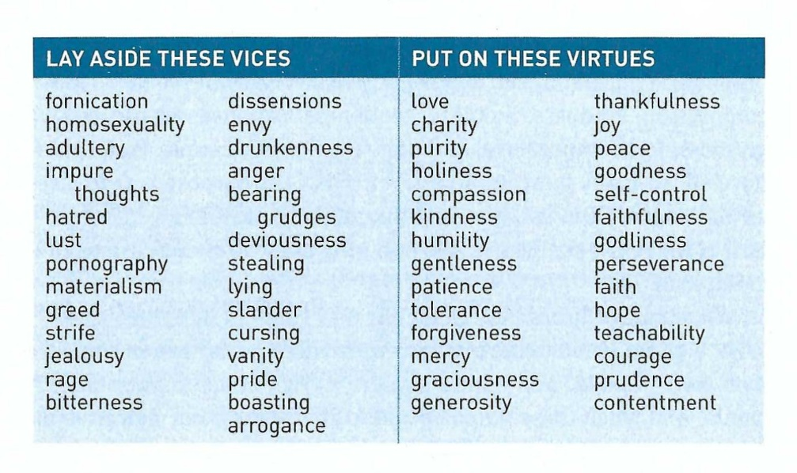
Application – Beginning Your Wardrobe change
This list does not completely mirror Paul’s list in verses 1–14, however it does give us a diagnostic tool to help evaluate our own Spiritual Wardrobe.

Slide 33
Application – Beginning Your Wardrobe change
So lets take a few moments to critically examine where we are in our personal spiritual wardrobe change.
Exercise:
Examine both list mark any vices or virtues you think tend to characterize your daily life. Mark only those things that have become habits (good or bad).
For each vice you need to discard find at least one virtue that would counter or cancel it out. Example: If you struggle with the vice of greed, you could cultivate the virtues of charity, generosity, and contentment.
Now consider other specific ways to begin putting off the sinful deeds of the old self and putting on the righteous deeds of the new self.

Slide 34
Application – Beginning Your Wardrobe change
Finally, remember that you can’t do this on your own.
Experience isn’t the best teacher, Guided Experience is:
You need the empowering work of the Holy Spirit.
The clear example of Jesus Christ.
The constant forgiveness that comes from God.
The strength that comes from team members – coaches, wise trusted pastors, counselors, mentors and fellow believers on the same journey, to help you along the way.
Then heed the: Spot-on Advice From a Seasoned Mentor!

Slide 35



Slide 36
NEXT CLASS – 29 Mar 2023
Book of Colossians
Before next class, read the below chapters in the NKJV and in one other versions of the Bible, i.e., KJV, NRSV, NIV, CEV, etc …
Chapter 3:15 – 4:1
“Wherever, Whatever, Whenever, However Christ”

Slide 37

the end
Questions
Questions

